Slide 1
PROGRAMING & INTRODUCTORY DATA STRUCTURE
RESTAURANT ORDER & BILLING SYSTEM
By: Khalid Alwaleed Ahmed

Slide 2
Problem Statement
The purpose of this program is to create a simple restaurant ordering & billing system using the C programming language. It allows the user to choose food and drinks from a menu, enter the quantity, and calculate the total bill.

Slide 3
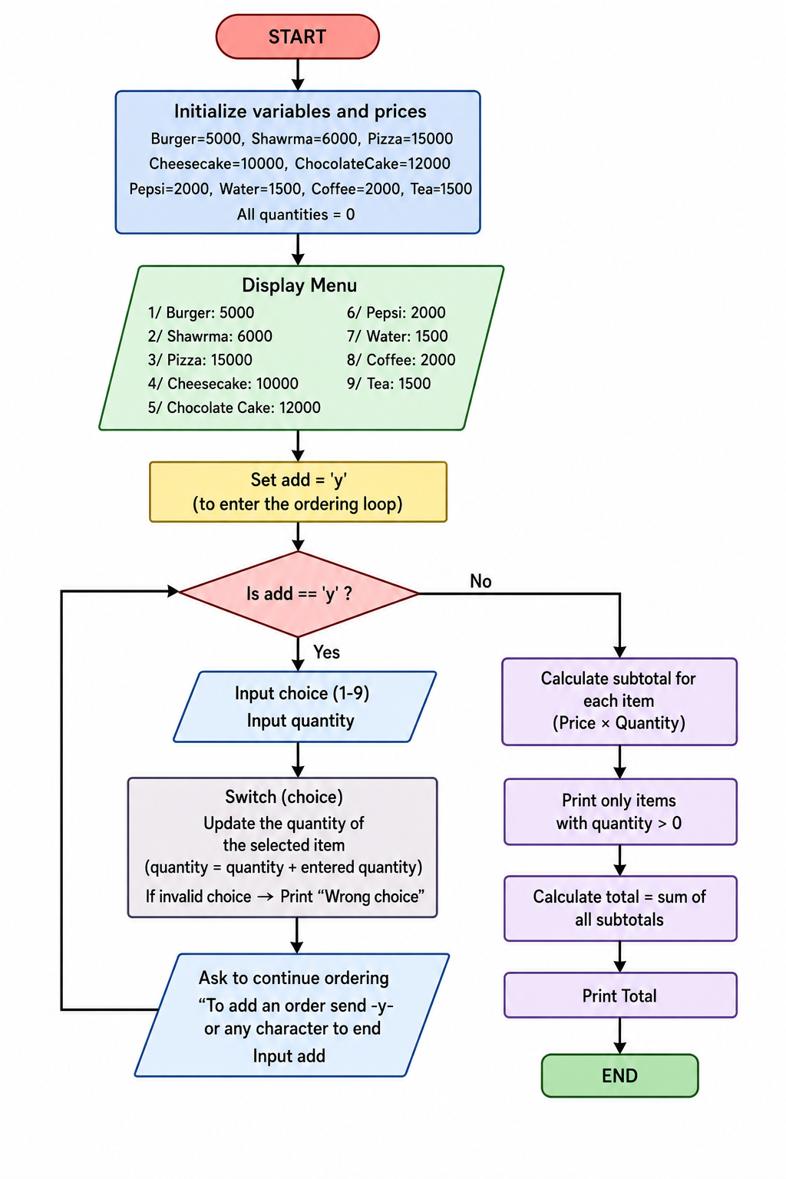
Flowchart

Slide 4
Results
Displays a menu with item prices.
Allows the user to add multiple orders.
Calculates the cost of each item based on the quantity.
Prints a final bill with the total amount.

Slide 5
Conclusion
The program successfully creates a simple restaurant ordering system. It demonstrates the use of basic C programming concepts such as variables, loops, switch statements, if statements, and input/output functions.

Slide 6
Recommendations
Add input validation to prevent invalid entries, Such as characters or negative numbers for quantity.
Allow users to edit or remove orders before printing the bill.
Add features such as discounts or tax calculation.
Improve the user interface to a graphical interface.

